Slide 1
CHAPTER 13
Authentication and
Access Control

Slide 2
OBJECTIVES
Explain the methods of network access security Filtering
Explain methods of user authentication

Slide 3
SECURITY FILTERING
The first line of defense is something called security filtering, which broadly refers to ways to let people securely access your resources. This process is twofold and includes ensuring that only authorized computers get to enter your network, and making sure data you’re sending back and forth between networks is secured so it can’t be intercepted and translated by bad guys.

Slide 4
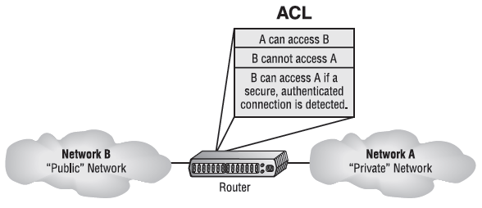
ACCESS CONTROL LISTS
Firewalls are basically tools that you can implement to prevent any unauthorized users roaming around on public networks from gaining access to your private network.
ACLs typically reside on routers to determine which devices are allowed to access them based on the requesting device’s Internet Protocol (IP) address.

Slide 5
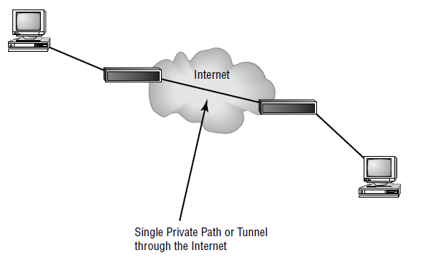
TUNNELING
Basically means encapsulating one protocol within another to ensure that a transmission is secure.
A tunnel through the Internet

Slide 6
TUNNELING (CONTD…)
Tunneling protocols:
Virtual P rivate Network (VPN)
Secure Sockets Layer (SSL)
Secure Sockets Layer Virtual Private Network (SSL VPN)
Layer 2 Tunneling Protocol (L2TP)
Point to Point Tunneling Protocol (PPTP)
Internet Protocol Security (IPSec)

Slide 7
VIRTUAL PRIVATE NETWORK (VPN)
There are three different categories of VPNs:
Remote access VPNs allow remote users like telecommuters to securely access the corporate network wherever and whenever they need to.
Site-to-site VPNs, or intranet VPNs, allow a company to connect its remote sites to the corporate backbone securely over a public medium like the Internet instead of requiring more expensive wide area network (WAN) connections like frame relay.
Extranet VPNs allow an organization’s suppliers, partners, and customers to be connected to the corporate network in a limited way for business-to-business (B2B) communications.

Slide 8
PPTP
Because PPTP uses two different protocols, it actually opens up two different network sessions: so be warned, it can give you some grief when passing through a router. This is a big reason you won’t find it around much nowadays. Another reason it’s going the way of the dinosaurs is that it originally gained popularity because it was the first VPN protocol to be supported by Microsoft’s dial-up networking services, and not too many of us depend on dial-up to get to the Internet anymore.

Slide 9
L2TP
L2TP is actually a combination of Microsoft’s Point-to-Point Tunneling Protocol (PPTP) and Cisco’s Layer 2 Forwarding (L2F) technologies. A nice L2TP feature is that because it works way down there at the Data Link layer (Layer 2) of the OSI model, it can support tons of protocols beyond just TCP/IP—a couple of biggies being Internetwork Packet Exchange (IPX) and AppleTalk.

Slide 10
IPSEC
IP Security (IPSec) was designed by the IETF for providing authentication and encryption over the Internet. It works at the Network layer of the OSI model (Layer 3) and secures all applications that operate in the layers above it. Because it’s sanctioned by the IETF and designed to work with IPv4 and IPv6, it’s got a huge amount of industry support, so it’s the standard for VPNs on the Internet today.
The two major protocols you’ll find working in IPSec are the Authentication Header (AH) and Encapsulating Security Payload (ESP). AH serves up authentication services only—no encryption—but ESP provides both authentication and encryption abilities.

Slide 11
ENCRYPTION
Without encryption, our sensitive files and information are essentially being paraded on full display as the data courses over the Internet.
Encryption works by running the data (which when encoded is represented as numbers) through a special encryption formula called a key that the designated sending and receiving devices both “know.” When encrypted data arrives at its specified destination, the receiving device uses that key to decode the data back into its original form.

Slide 12
THE DATA ENCRYPTION STANDARD (DES)
Basically, DES uses lookup and table functions, and it actually works much faster than public-key systems. It uses 56-bit private keys. RSA Data Systems once issued a challenge to see if anyone could break the key. A group of Internet users worked together to attempt the task, with each member dealing with a portion of the 72 quadrillion possible combinations. They succeeded and cracked the key in June 1997, after searching only 18 quadrillion keys.

Slide 13
THE ADVANCED ENCRYPTION STANDARD (AES)
The Advanced Encryption Standard (AES, also known as Rijndael) has been the “official” encryption standard in the United States since 2002. It specifies key lengths of 128, 192, or 256 bits.
Hackers attempt to use power consumption, electromagnetic leaks, or timing information (like the number of processor cycles taken to complete the encryption process) to give them critical clues about how to break the AES system. Although it’s true that attacks like these are possible to pull off, they’re not really practical to clinch over the Internet.

Slide 14
PUBLIC KEY ENCRYPTION
Public key encryption uses the Diffie-Hellman algorithm, which employs a public key and a private key to encrypt and decrypt data.
The sending machine’s public key is used to encrypt a message to the receiving machine that it uses to decrypt the message with a private key. It’s a one-way communication, but if the receiver wants to send a return message, it does so via the same process. If the original sender doesn’t have a public key, the message can still be sent with a digital certificate that’s often called a digital ID, which verifies the sender of the message.

Slide 15
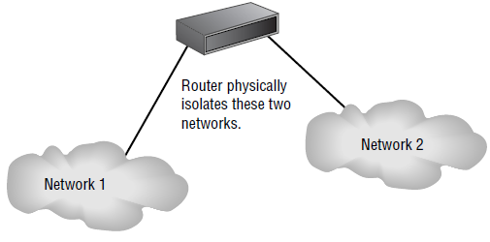
RAS
Remote Access Services (RAS) is not a protocol but refers to the combination of hardware and software required to make a remote-access connection. The term was popularized by Microsoft when the company began referring to its Windows NT–based remote-access tools under this name.

Slide 16
MANAGING USER ACCOUNT AND PASSWORD SECURITY
Usernames and passwords are vital to network security because their whole purpose is to control initial access to it. Even if the system administrator assigns individuals their usernames and passwords, users can and do often change them; so, you need to make sure your network’s users know the difference between a good password and a bad one and how to keep their passwords safe from theft.

Slide 17
MANAGING USER ACCOUNTS
Disabling Accounts
Leave the account in place.
Delete the account.
Disable the account.

Slide 18
MANAGING PASSWORDS
Basically, a strong password is some combination of alphanumeric and special characters that’s easy for you to remember but really hard for someone else to guess. Like server account names, they should never be written down and stuck into your desk or onto your computer. Unfortunately, this only happens in a perfect world—users invariably try to make things easy on themselves by choosing passwords that are so simple to guess, you’d have to be seriously mentally challenged not to be able to. Let’s look at some characteristics of strong passwords.

Slide 19
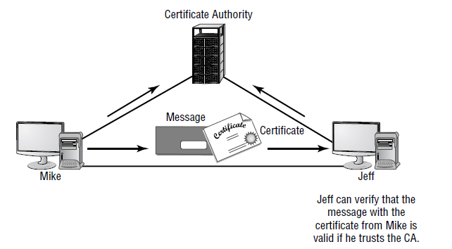
USER-AUTHENTICATION METHODS
Public Key Infrastructure (PKI)
Public Key Infrastructure (PKI) is a system that links users to public key that verifies the user’s identity by using a certificate authority (CA).

Slide 20
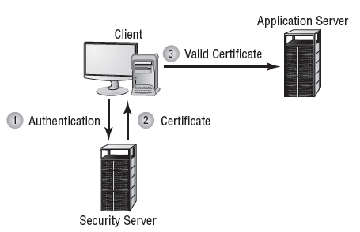
USER-AUTHENTICATION METHODS (CONTD…)
Kerberos
Kerberos, created at MIT, isn’t just a protocol, it’s an entire security system that establishes a user’s identity when they first log on to a system that’s running it. It employs strong encryption for all transactions and communication, and it’s readily available. The source code for Kerberos can be freely downloaded from lots of places on the Internet.

Slide 21
AUTHENTICATION, AUTHORIZATION, AND ACCOUNTING (AAA)- RADIUS
The Remote Authentication Dial-In User Service (RADIUS) is not a dial-up server.
RADIUS is an authentication and accounting service that’s used for verifying users over various types of links, including dial-up.
RADIUS is also used in firewalls. Purposed this way, when a user wants to access a particular TCP/IP port, they must provide a username and a password. The firewall then contacts the RADIUS server to verify the credentials given. If successful, the user is granted access to that port.

Slide 22
AUTHENTICATION, AUTHORIZATION, AND ACCOUNTING (AAA)- TACACS+
The Terminal Access Controller Access-Control System Plus (TACACS+) protocol is an alternative AAA method to RADIUS.
Here are two major differences between TACACS+ and RADIUS:
RADIUS combines user authentication and authorization i NN nto one profile, but TACACS+ separates the two.
TACACS+ utilizes the connection-based TCP protocol, but RADIUS uses UDP instead.

Slide 23
CHALLENGE HANDSHAKE AUTHENTICATION PROTOCOL (CHAP)
The Challenge Handshake Authentication Protocol (CHAP) is a secure authentication protocol because with CHAP, the username and password never cross the wire. Instead, both the client and server are configured with the same text phrase that’s known as a shared secret. When a client sends out an authentication request, the server responds by sending a random value called a nonce plus an ID value back to the client.

Slide 24
MS-CHAP
Microsoft has its own variation of CHAP known as Microsoft Challenge Handshake Authentication Protocol (MS-CHAP). It works basically the same way as CHAP, except that unlike CHAP, which requires the shared secret to be stored locally in clear text, MS-CHAP encrypts the secret locally. And whereas CHAP provides authentication of the client by the server only, MS-CHAP version 2 is capable of mutual authentication so that the client can be sure the server is legitimate as well.

Slide 25
EXTENSIBLE AUTHENTICATION PROTOCOL (EAP)
Extensible Authentication Protocol (EAP) is an extension to PPP that provides a host of additional authentication methods for remote access clients. Some examples include smart cards, certificates, Kerberos, and biometric schemes like retinal scans and fingerprint and voice recognition. Although EAP itself doesn’t allow for mutual authentication, enhanced forms of the protocol do. For example, EAP-TLS and EAP-TTLS, a tunneled version of EAPTLS, create a secure tunnel through which password-based versions like EAP-MD5 can run.

